Slide 1
AI-Powered Collections Strategy
Leveraging Agentic AI for Scalable, Fair, and Effective Debt Management at Geldium

Slide 2
How the System Works
Inputs: Collects customer data like credit utilization, missed payments, and DTI from internal sources.
Decision Logic: Applies a predictive model and business rules to assess delinquency risk.
Actions: Automatically triggers tailored interventions like reminders or financial support offers.
Learning Loop: Continuously monitors outcomes and updates the model to improve future decisions.

Slide 3
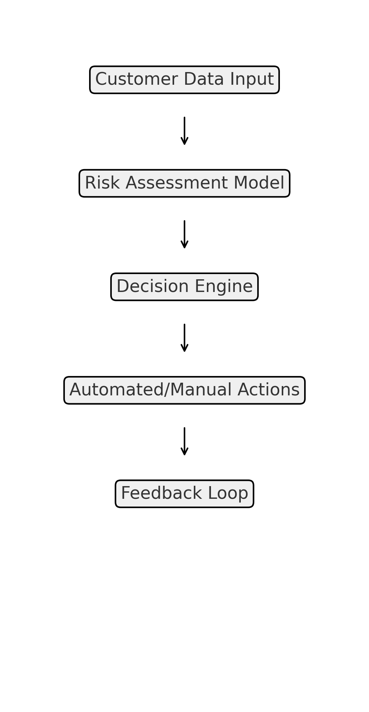
System Workflow Diagram

Slide 4
Role of Agentic AI
Autonomous Tasks | Human Oversight Tasks
Run risk scoring using the predictive model | Review hardship and restructuring cases
Send automated reminders via SMS/email | Approve exceptions or edge-case actions
Flag high-risk accounts for proactive outreach | Oversee fairness and compliance of AI decisions
Recommend standard interventions (e.g., budget tips) | Final decision-making for complex or sensitive customers

Slide 5
Responsible AI Guardrails
Fairness audits across income, gender, and region
Explainable models with clear decision logic
Compliance with GDPR, DPDP, and financial regulations
Human oversight for sensitive actions
Notes:
.

Slide 6
Expected Business Impact
💼 Business KPIs
↓ Delinquency by 20%
↑ Repayment engagement
↓ Collection costs
👥 Customer Outcomes
Fairer, faster support
↑ Trust and satisfaction
Transparent decisions

Slide 7
Thank You

